Slide 1


A Conception On Wi- Vi Technology
Presented By:Jv’n Chhavi Sharma
Jv’n Swati Mundra
B.Tech(CSE) 2nd Year
Jayoti Vidyapeeth Women’s University

Slide 2

INTRODUCTION
Remote Vision (Wi-Vi) is another innovation like a similar idea of Wi-Fi which empowers seeing through dividers with the assistance of Wi-Fi signals.
Wi-Vi enables us to follow moving people through dividers just as away from plain view.
Wi-Vi's task does not require any entrance to any gadget on the opposite side of the divider.

Slide 3

WHAT WI-VI CAN DO-
Detect the Number of Moving Humans in a Closed Room.
Enable Communication through a Wall without Carrying a Wireless Device.
Identify Simple Gestures from Behind a Wall.

Slide 4

RELATED WORK
Wireless Systems
One can arrange the related work in this space into three fundamental classes:
remote restriction,
remote tomography, and
through-the-divider radar systems.

Slide 5

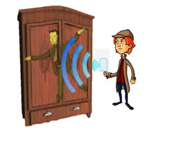
WIRELESS SYSTEMS

Slide 6

Gesture Postures:
It can identify and group these nine motions in :
observable pathway,
non-viewable pathway, and
through-the-divider.

Slide 7

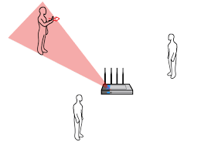
GESTURE POSTURES

Slide 8
Applications of Wi-Vi:
Emergency Situation
Law Enforcement
Personal Security
Smart Sensing
Entertainment

Slide 9
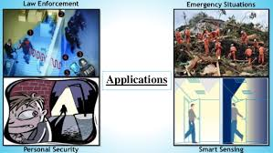
APPLICATIONS

Slide 10

ANALYSIS
Wi-Vi can empower a human who does not convey any remote gadget to impart short messages or directions.
Wi-Vi speaks to these attempt of motions by „0‟ bit and „1‟ bit.
These motions are later made by human to make messages that are having totally extraordinary translations.

Slide 11

ADVANTAGES OF WI-VI
The framework utilizes just a single collector.
Low cost Wi-Fi innovation framework.
It does not require a viewable pathway between the client and the gadget.
It does not require an observable pathway between the clients what's more, the gadget.

Slide 12

FUTURE SCOPE
Wi-Vi framework is best framework to perceive moving item behind the divider.
numerous enhancements can make this framework increasingly precise and better.
Enhancements will additionally permit Wi-Vi to catch higher quality pictures empowering the gesture-based interface.

Slide 13

CONCLUSION
Wi-vi could be built in a smartphone or special handheld devices.
Evolution of seeing human beings through denser building material with longer range.
High quality images.

Slide 14


